Slide 1
8.2 Definition of linear maps and linear operators

Slide 2
Introduction
In this topic, we will
Define a linear map
Understand what it implies
Describe a test for linearity
Look at some examples
See that all finite-dimensional linear maps can be represented by matrices
Learn that the image of a linear map can be calculated by performing a matrix-vector multiplication

Slide 3
Background
The two operations we can perform on vectors is:
Scalar multiplication: α u
Vector addition: u + v
Definition:
A map A:U →V is said to be a linear map if both
A(α u) = α Au
A(u₁ + u₂) = Au₁ + Au₂
The response to a linear combination of inputs is equal to that same linear combination of the responses to the individual inputs
A(α u₁ + β u₂) = α Au₁ + β Au₂

Slide 4
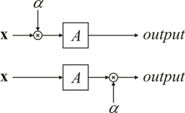
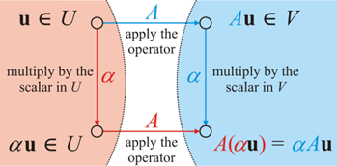
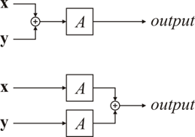
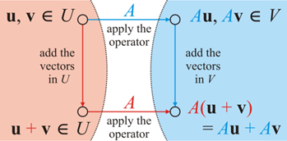
The superposition principle
Visually, we can approach this in two ways:

Slide 5
Results
Theorem
If A:U →V is linear, then A0_{U} = 0_{V} .
That is, the zero vector in U is mapped to the zero vector in V
Proof:
Let u be any vector in U
Recall that 0u = 0_{U}
Thus, A0_{U} = A(0u) = 0 Au
= 0_{V} ▮
but Au is a vector in V

Slide 6
Results
Theorem
If A:U →V is linear, then A maps lines onto lines or a single point.
Proof:
A line is of the form u₁ + α u₂ in U
Thus, A(u₁ + α u₂) = Au₁ + α Au₂
If Au₂ = 0_{V} , then A(u₁ + α u₂) = Au₁
Otherwise, Au₂ ≠ 0_{V} , in which case, the result is a line in V . ▮

Slide 7
Results
Theorem
If A:U →V is linear and Au₁ = Au₂ = v ∈V , then A(α u₁ + (1 – α)u₂) = v for all α ∈ F.
Proof:
A(α u₁ + (1 – α)u₂) = α Au₁ + (1 – α)Au₂
= α v + (1 – α)v
= (α + 1 – α)v = 1·v = v ▮
Note, this says: if there are two solutions, to Au = v, then there are infinitely many solutions

Slide 8
Results
Theorem
If A:U →V is linear and Au₁ = Au₂ = v ∈V , then A(u₁ – u₂) = 0_{V} .
Proof:
A(u₁ – u₂) = Au₁ – Au₂
= v – v
= 0_{V} ▮

Slide 9
Background
Definition:
A map A:U →U is said to be a linear operator if the domain and codomain are the same vector space.
Definition
Given two linear maps, A, B:U →V , we will say that A = B if and only if Au = Bu for all u ∈ U .

Slide 10
Proving linearity
You can show a map A:U →V is linear by either showing:
A(α u) = α Au for all u ∈ U and all α ∈ F A(u₁ + u₂) = Au₁ + Au₂ for all u₁, u₂ ∈ U
A(α u₁ + β u₂) = α Au₁ + β Au₂ for all u₁, u₂ ∈ U and all α, β ∈ F
You can show one or the other, Requirement 1 is true if and only if Requirement 2 is true.
To show that A:U →V is not linear, it is only necessary to show one of:
A(0_{U} ) ≠ 0_{V}
A(α u) ≠ α A(u) for one u ∈ U and one α ∈ F
A(u₁ + u₂) ≠ Au₁ + Au₂ for two specific u₁, u₂ ∈ U

Slide 11
Examples
Let A:R² → R³ be defined as
Now,

Slide 12
Examples
Let B:R⁴ → R² be defined as
Well,
and , so this B is not linear

Slide 13
Examples
Let C:R³ → R² be defined as
Now, ,
so using the same approach as for A, we can show that C, too, is linear

Slide 14
Examples
Let D:R⁴ → R⁴ be defined as
Now, ,
so using the same approach as for A and C, we can show that D, too, is linear

Slide 15
Examples
Let E:R² → R² be defined as
Now, , so we can’t do this easily…
However, and
But
Thus, E is not linear

Slide 16
Examples
Let F:R¹ → R¹ be defined as
Now, ,
so F is not linear

Slide 17
Examples
Let G:R² → R² be defined as
Now, , yet and ,
but
Thus, G is not linear

Slide 18
A general observation…
For finite-dimensional vector spaces,
it seems that a mapping A:F^{n} → F^{m} is linear if and only if A is defined as the entries of u being the coefficients of a linear combination of n vectors in F^{m}
That is, there exist n vectors v₁, …, v_{n} such that
Au = u₁ v₁ + ··· + u_{n} v_{n}

Slide 19
A general observation…
Can we go the other way?
Given a linear mapping A:F^{n} → F^{m}, does it necessarily define a linear combination of n vectors in F^{m} with coefficients from the vector u from F^{n}
That is, if A is linear, do there exist n vectors v₁, …, v_{n} such that
Au = u₁ v₁ + ··· + u_{n} v_{n}

Slide 20
A general observation…
Solution:
In the domain F^{n},
let be the canonical basis, so , etc.
Define , so given any vector u ∈ F^{n},
we see

Slide 21
Matrix representation of a linear map
Now, given a linear map A:F^{n} → F^{m}, we will represent A as the m × n matrix
Each column and we will describe Au as the matrix-vector multiplication

Slide 22
Matrix representation of a linear map
It is also possible to think of matrix-vector multiplication as follow:

Slide 23
Examples
Recall A:R² → R³ was
The matrix representation is
For example, if then

Slide 24
Examples
Recall C:R³ → R² was
The matrix representation is
For example, if then

Slide 25
Examples
Recall D:R⁴ → R⁴ was
The matrix representation is
If then

Slide 26
Summary
Following this topic, you now
Understand the definition of linearity
Know the test for linearity
Know also how to show a mapping is not linear
Know that the zero vector is always mapped to the zero vector by a linear mapping
Have observed a number of examples
Know that a finite-dimensional linear map can always be represented by a matrix
Understand matrix-vector multiplication

Slide 27
References
[1] https://en.wikipedia.org/wiki/Linear_map

Slide 28
Acknowledgments
None so far.

Slide 29
Colophon
These slides were prepared using the Cambria typeface. Mathematical equations use Times New Roman, and source code is presented using Consolas. Mathematical equations are prepared in MathType by Design Science, Inc.
Examples may be formulated and checked using Maple by Maplesoft, Inc.
The photographs of flowers and a monarch butter appearing on the title slide and accenting the top of each other slide were taken at the Royal Botanical Gardens in October of 2017 by Douglas Wilhelm Harder. Please see
https://www.rbg.ca/
for more information.

Slide 30
Disclaimer
These slides are provided for the ne 112 Linear algebra for nanotechnology engineering course taught at the University of Waterloo. The material in it reflects the authors’ best judgment in light of the information available to them at the time of preparation. Any reliance on these course slides by any party for any other purpose are the responsibility of such parties. The authors accept no responsibility for damages, if any, suffered by any party as a result of decisions made or actions based on these course slides for any other purpose than that for which it was intended.

